Slide 1

HACC Challenge: Open Source Based Reporting Online
Office of Hawaiian Affairs
8/26/2017

Slide 2
About OHA
The Office of Hawaiian Affairs is a state agency with a high degree of autonomy
OHA is responsible for improving the well-being of Native Hawaiians
OHA is governed by a Board of Trustees made up of nine members from all islands
OHA annually provides Native Hawaiian students >$800,000 in scholarship money;
OHA annually provides ~$10,000,000 grants to education, health, housing, and other strategic priorities

Slide 3
Year 2013-16 Grants
OHA Strategic Results | Amount
Build Stability in Housing | 13,181,262
Exceed Education Standards | 12,021,286
Priority Level | 2,939,804
Achieve Pae Aina Sustainability | 1,872,969
Increase Family Income | 1,762,550
Improve Family Lifestyle | 1,398,768
Decrease Chronic Disease Rates | 955,840
Participate in Culture | 945,155
Value History and Culture | 806,385
TOTAL | 35,884,019

Slide 4
Grants Table
Fiscal Year
Grant Type
Organization
Project
Amount
Location
Strategic Priority
Strategic Results
TOTAL # SERVED
# NH SERVED
Grant Status
Download link: https://19of32x2yl33s8o4xza0gf14-wpengine.netdna-ssl.com/wp-content/uploads/OHA-Grantees-2013-to-2016.pdf

Slide 5
Grants Table
Fiscal Year | Grant Type | Organization | Project | Amount | Location | Strategic Priority | Strategic Results | TOTAL # SERVED | # NH SERVED
2013 | Community Grant | University of Hawaii - Office of Research Services | To support Aka Lehulehu to provide an integrated career and research-focused internship program to undeclared Native Hawaiian undergraduate students attending University of Hawaiʻi Mānoa. (Year 2 of 2) | 90000 | Statewide | Education | Exceed Education Standards | 26 | 26
2013 | Community Grant | PACT | To provide employment and placement services to various communities on Kona, Hawaii using approaches that have proven successful in Native Hawaiian homesteads on Oahu. | 124500 | Hawaii | Economic Self-Sufficiency | Increase Family Income | 30 | 30
2013 | Community Grant | Goodwill Industries of Hawaii | To provide comprehensive services and training to prepare and assist unemployed or underemployed low-income persons to obtain and maintain employment. | 150000 | Oahu | Economic Self-Sufficiency | Increase Family Income | 32 | 32
2013 | Community Grant | Goodwill Industries of Hawaii | To provide comprehensive services and training to prepare and assist unemployed or underemployed low-income persons to obtain and maintain employment. | 150000 | Hawaii | Economic Self-Sufficiency | Increase Family Income | 34 | 34
2013 | Community Grant | PACT | To provide employment and placement services at various public housing and low-income communities, specifically Waimanalo and Papakolea homesteads on Oahu. | 150000 | Oahu | Economic Self-Sufficiency | Increase Family Income | 53 | 53
2013 | Community Grant | Helping Hands | Provide emergency financial assistance payments necessary to maintain housing, as well as ongoing case management and referral services. (Year 2 of 2) | 41325 | Oahu | Economic Self-Sufficiency | Build Stability in Housing | 54 | 54
2013 | Community Grant | Kokua Kalihi Valley Comprehensive Family Services | Help keiki and their ʻohana discover healthy lifestyle choices | 125000 | Oahu | Health | Improve Family Lifestyle | 59 | 59
2013 | Community Grant | University of Hawaii - Office of Research Services | To support Hookulaiwi to prepare outstanding educators and educational leaders to bring about community-based, systemic, long-term educational reviatlization of Hawaiʻi communities of highest need. (Year 2 of 2) | 195000 | Statewide | Education | Exceed Education Standards | 66 | 37

Slide 6
Who is the Target Audience
General public
Grant applicants
OHA trusttees
Grants inspectors
Auditors

Slide 7
User Interface Requirements
Filter by location, strategic priority, grantees, time;
Slice and dice or drill down to each categories;
Change charts on the fly, e.g. from Pie chart to Bar chart;
Save, export to other formatted data

Slide 8
Platform Requirements
Implemented in Open Source based platform
Portable
Compatible
Dynamic user interface

Slide 9
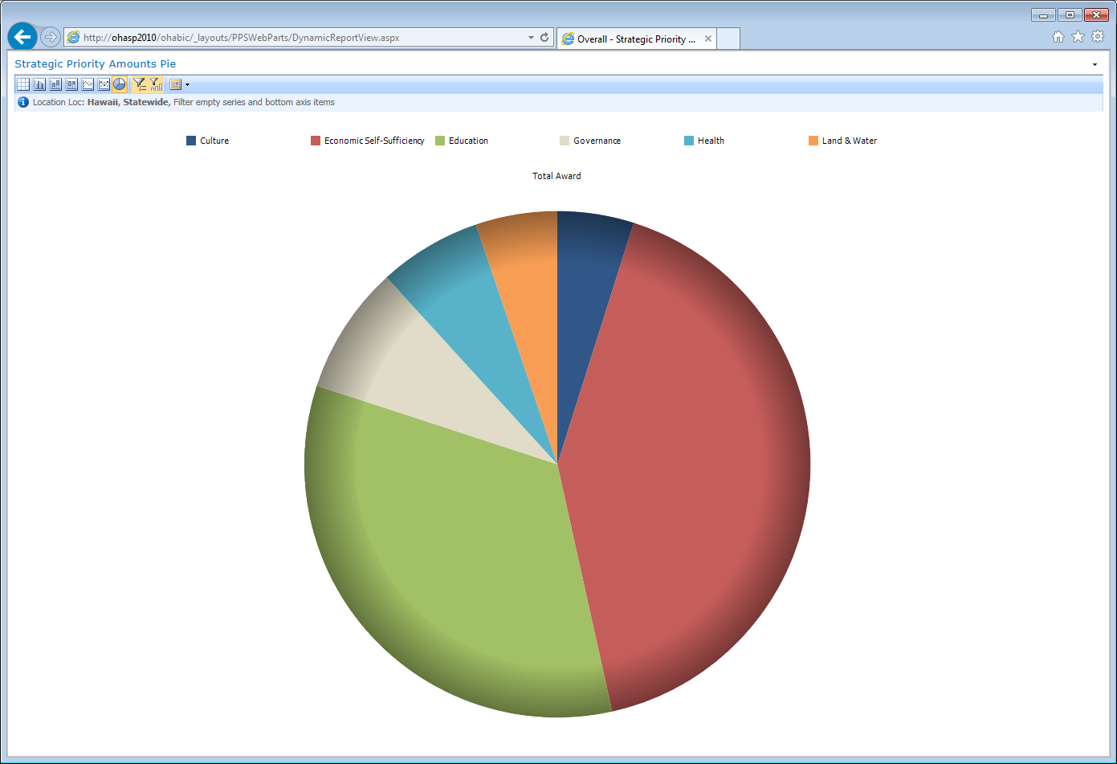
Grants Distribution Based on Strategic Priorities

Slide 10
Grants By Organization

Slide 11
Q&A
Mahalo nui!

